Slide 1
Cryptography: Basics

Slide 2
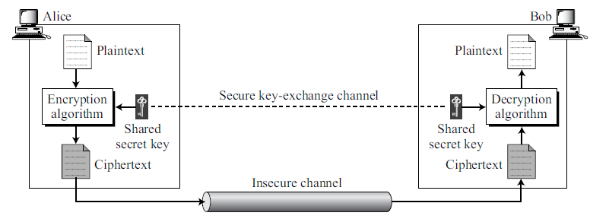
Symmetric (Secret) Key Cryptography
Encryption: C = E_{k}(P) Decryption: P = D_{k}(C)
In which, D_{k}(E_{k} (x)) = E_{k}(D_{k} (x)) = x

Slide 3
Cryptanalysis
In the brute-force method or exhaustive-key-search method, Eve tries to use all possible keys. To prevent this type of attack, the number of possible keys must be very large.
Cryptography is the science and art of creating secret codes, cryptanalysis is the science and art of breaking those codes.
Cryptanalysis Attack? ( How much information is known to an attacker?) (Assumption: Algorithm is known to an attacker)
CT only Attack
Known PT Attack
Chosen PT Attack
Chosen CT Attack

Slide 4
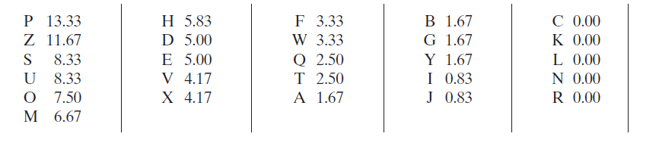
Traditional Ciphers
Approaches for creating CT from PT : Substitution & Transposition
Mono-Alphabetic (Ceaser)
Poly- Alphabetic
Prone to Statistical Attack
Relative frequency of the letters (in percentage) within CT can be
Computed and used to find out PT.
Similarly frequency of two letters combination can be found for
Statistical attack.

Slide 5
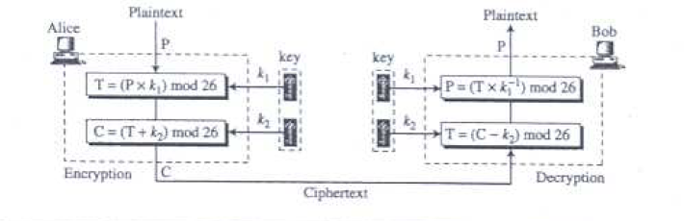
Affine Cipher: Substitution Cipher
C = (P X K1 + K2) MOD 26 P = (C + (-K2) X K1 ⁻¹ ) MOD 26

Slide 6
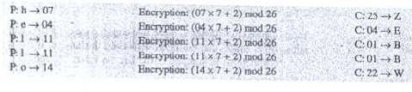
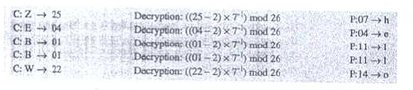
Affine Cipher: Example
Key value pair (7,2), PT : “HELLO”
eg. Multiplicative inverse of 7 in Z₂₆ will be 15 as (15 x 7) mod 26 = 1; 23 x 15 mod 26 = 345 mod 26 = 7 i.e h

Slide 7
Modular Arithmetic
Set of Residue, Z_{n} = { 0, 1, 2, 3, . . . , (n − 1) }
We often used the concept of congruence instead of equality. Mapping from Z to Z_{n} is not one-to-one. Infinite members of Z can map to one member of Zn. For example, the result of 2 mod 10 = 2, 12 mod 10 = 2, 22 mod 2 = 2, and so on. 2 ≡ 12 (mod 10) 13 ≡ 23 (mod 10)
In Zn, two numbers a and b are additive inverses of each other if in Zn, a + b = 0 ; the additive inverse of a can be calculated as b = n − a. For example, the additive inverse of 4 in Z₁₀ is 10 − 4 = 6.
In Zn, two numbers a and b are the multiplicative inverse of each other if a x b = 1 (mod n). For example, the multiplicative inverse of 3 in Z₁₀ is 7.
In modular arithmetic, an integer may or may not have a multiplicative inverse.

Slide 8
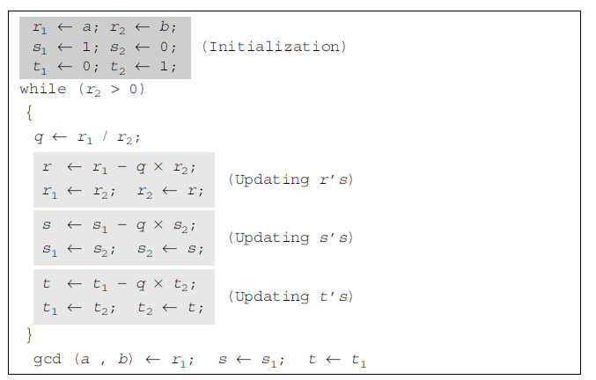
Extended Euclidean Algorithm
Given two integers a and b, we often need to find other two integers, s and t, such that (s x a) + (t x b) = gcd (a,b)

Slide 9
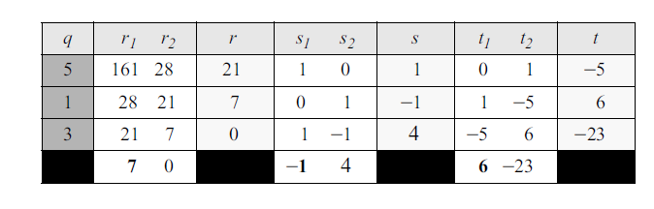
GCD Computation: Example
GCD of (161, 28) = 7 ; s = -1 & t = 6 Thus -1 x 161 + 6 x 28 = 7
The integer a in Zn has a multiplicative inverse if and only if gcd (n, a) ≡ 1 (mod n) Co-Prime

Slide 10
Multiplicative Inverse
The extended Euclidean algorithm finds the multiplicative inverses of b in Z_{n} when n and b are given and gcd (n, b) = 1.
The multiplicative inverse of b is the value of t after being mapped to Z_{n}.
let us replace the first integer a with n (the modulus). We can say that the algorithm can find s and t such s × n + b × t = gcd (n, b). However, if the multiplicative inverse of b exists, gcd (n, b) must be 1. So the relationship is (s x n) + (b x t ) = 1.
(s × n + b × t) mod n = 1 mod n
[(s × n) mod n] + [(b × t) mod n] = 1 mod n
0 + [(b × t) mod n] = 1
(b × t) mod n = 1 → This means t is the multiplicative inverse of b in Z_{n}

Slide 11
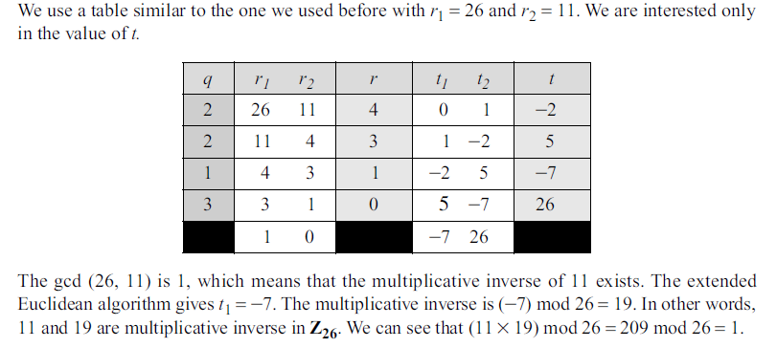
Multiplicative inverse of 11 in Z ₂₆

Slide 12
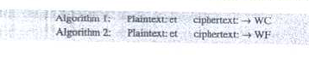
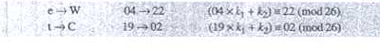
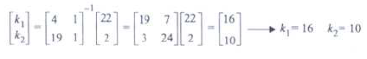
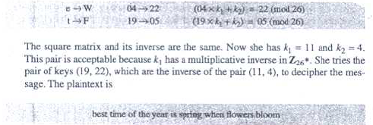
Chosen PT attack on Affine Cipher
K1 = 16 is not at all an acceptable solution as there is no multiplicative inverse of 16 in Z_{26*}

Slide 13
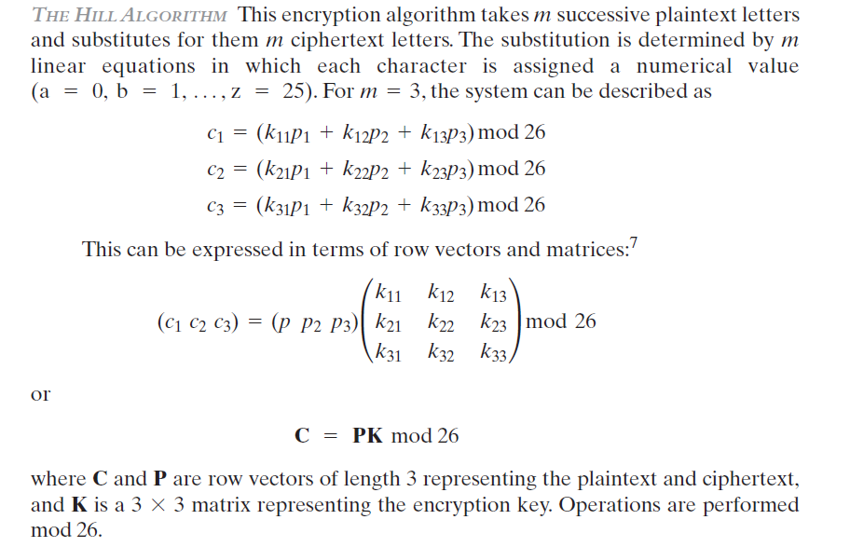
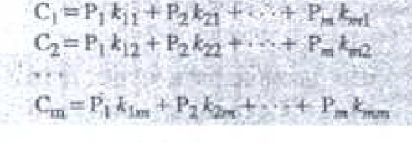
Hill Cipher

Slide 14
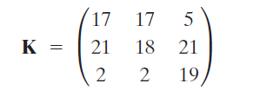
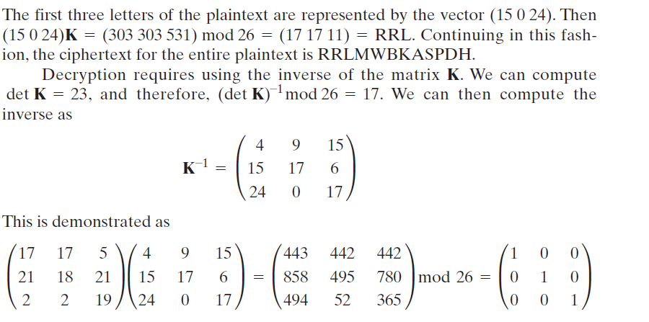
Hill Cipher: Example
PT = PAY MORE MONEY

Slide 15
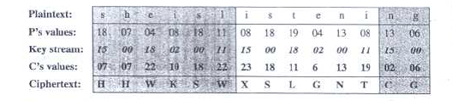
Poly-Alphabetic: Vigenere Cipher
Vigenere key stream is not dependent on the PT; rather the position
of the character within PT.

Slide 16
Inverse of 550 in GF(1759)
Q | A1 | A2 | A3 | B1 | B2 | B3
— | 1 | 0 | 1759 | 0 | 1 | 550
3 | 0 | 1 | 550 | 1 | –3 | 109
5 | 1 | –3 | 109 | –5 | 16 | 5
21 | –5 | 16 | 5 | 106 | –339 | 4
1 | 106 | –339 | 4 | –111 | 355 | 1
Notes:
Example showing how to find the inverse of 550 in GF(1759), adapted from Stallings Table 4.4. In this example, let us use a = 1759 and b = 550 and solve for 1759x + 550y = gcd(1759, 550). The results are shown in Table 4.4. Thus, we have 1759 x (–111) + 550 x 355 = –195249 + 195250 = 1.

Slide 17
Find all multiplicative inverses in Z_{10.}
Find all multiplicative inverses in Z_{11.}
The integer a in Z_{n} has a multiplicative inverse iff gcd (n,a) = 1 (mod n)
Using extended Eucledian algo, we can say that gcd (a,b) = (x * a) + (b * y) ; replace a with n, we get gcd (a,b) = (x * n) + (b * y)
Or, (x * n) + (b * y) = 1
Or, (x * n) + (b * y) mod n = 1 mod n
Or, (b * y) mod n = 1 mod n
i.e. b is multiplicative inverse of y in z_{n.}

Slide 18
Stream & Block Ciphers
A stream cipher is one that encrypts a digital data stream one bit or one byte at a time. e.g. Auto keyed Vigenère cipher, Vernam cipher.
In the ideal case, a one-time pad version of the Vernam cipher would be used, in which the key stream is as long as the plaintext bit stream.
Random cryptographic key stream ensures the strength.
A block cipher is one in which a block of plaintext is treated as a whole and used to produce a cipher text block of equal length. Typically, a block size of 64 or 128 bits is used.

Slide 19
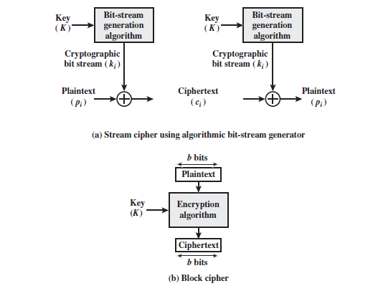
Stream & Block Cipher

Slide 20
Block Cipher
There are possible different plaintext blocks and for the encryption to be reversible (i.e., for decryption to be possible), each must produce a unique cipher text block. Such transformation is called reversible or nonsingular.
Using large block and an arbitrary reversible substitution between plaintext and cipher text, the statistical characteristics of the source plaintext are masked; thus cryptanalysis attack due to small block size is infeasible.

Slide 21
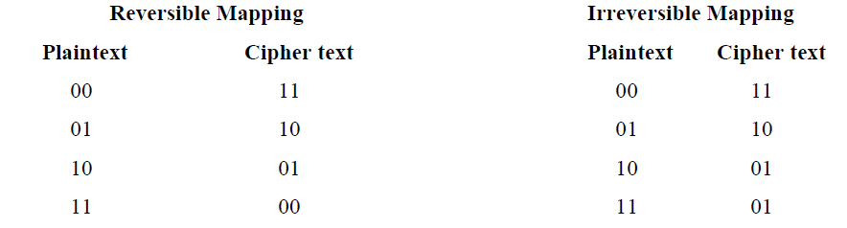
Reversible Mapping
In the latter case, a ciphertext of 01 could have been produced by one of two plaintext blocks. So if we limit ourselves to reversible mappings, the number of different transformations is 2^{n}!
Possible Input & Output pattern: 2^{n}
For the first plaintext, we can choose any one from the 2^{n} of ciphertext blocks. For the second plaintext, we choose from among 2^{n} - 1 remaining ciphertext blocks, and so on.

Slide 22
Motivation: Feistel Cipher
Ideal block cipher allows maximum number of possible encryption mappings from the plaintext block.
Classical (Ideal) substitution ciphers are vulnerable to a statistical analysis of the plaintext. This weakness is due to the use of a small block size.
For large and an arbitrary reversible substitution between plaintext and cipher text is allowed, the statistical characteristics of the source plaintext are masked and cryptanalysis is infeasible.
An arbitrary reversible substitution cipher (the ideal block cipher) for a large block size is not practical.

Slide 23
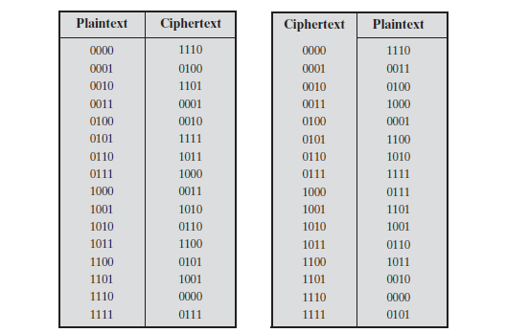
Ideal Cipher for n =4

Slide 24
Motivation: Feistel Cipher
Assume n =4. The method of defining the key length of (4 bits) × (16 rows) = 64 bits.
In general it will be n × 2^{n} bits. For a 64-bit block, the desirable key length will be 64 × 2⁶⁴ =2⁷⁰ =10²¹ bits .
Feistel points out that what is needed is an approximation to the ideal block cipher system for large n, built up out of components that are easily realizable.

Slide 25
Feistel Cipher
Feistel proposed that we can approximate the ideal block cipher by utilizing the concept of a product cipher.
Product cipher is the execution of two or more simple ciphers in sequence in such a way that the final result or product is cryptographically stronger than any of the component ciphers.
The essence of the approach is to develop a block cipher with a key length of k bits and a block length of n bits, allowing a total of possible 2^{k} transformations, rather than the 2^{n}! transformations available with the ideal block cipher.

Slide 26
Confusion & Diffusion
Shannon suggests two methods for frustrating statistical cryptanalysis: diffusion and confusion.
In diffusion, the statistical structure of the plaintext is dissipated into long-range statistics of the cipher text. This is achieved by having each plaintext digit affect the value of many cipher text digits.
Confusion seeks to make the relationship between the statistics of the cipher text and the value of the encryption key as complex as possible, again to prevent attempts to discover the key.

Slide 27
Feistel Structure
Feistel proposed the use of a cipher that alternates substitutions and permutations
Substitution: Each plaintext element or group of elements is uniquely replaced by a corresponding cipher text element or group of elements.
Permutation: A sequence of plaintext elements is replaced by a permutation of that sequence.
Non-fiestel cipher uses only invertible components. E.g. AES
Feistel cipher uses invertible, Self-invertible and non-invertible components, but the overall effect becomes invertible.

Slide 28
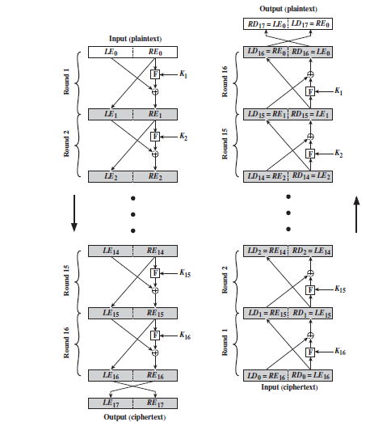
Feistel Structure

Slide 29
Feistel Cipher: Performance Metrics
The exact realization of Feistel Cipher depends on:
Block Size
Key Size
Round Function
Number of Rounds
Sub-key generation Algorithm
Two more issues :
Fast Encryption/ Decryption
Ease of Analysis

Slide 30
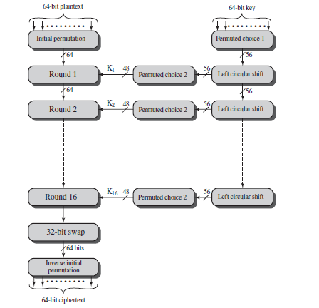
Data Encryption Standard (DES)

Slide 31
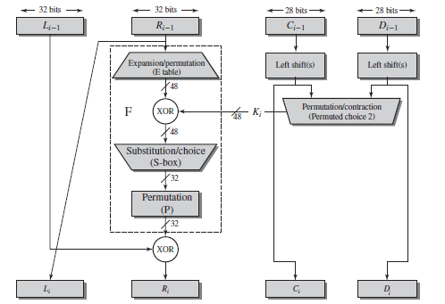
DES: Round Function

Slide 32
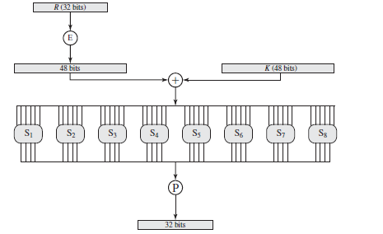
DES: S-Box

Slide 33
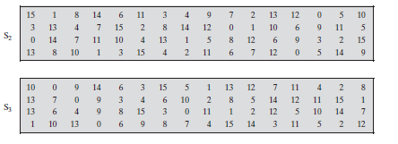
Sample S-Box

Slide 34
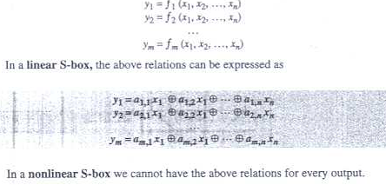
S-Box
S-Box is a essentially a Substitution function with m inputs and n outputs ( m and n may not be equal) , in general it is Keyless.

Slide 35
DES Analysis
Two desirable properties; Avalanche Effect (a small change in PT makes significant change in CT) & Completeness ( Each bit of CT needs to depend many bits of PT)
DES performs satisfactory in terms of the above said properties.

Slide 36
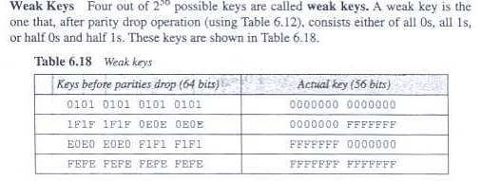
DES: Analysis

Slide 37
Mathematics: Pre-requisite for Cryptography

Slide 38
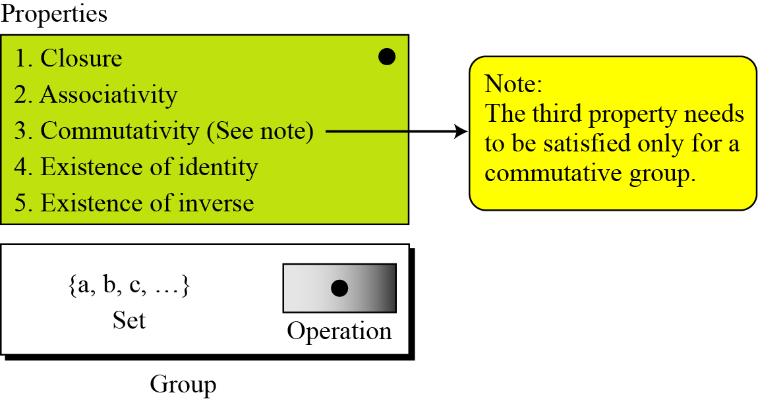
Group

Slide 39
Group....
Although a group involves a single operation, the properties imposed on the operation allow the use of a pair of operations as long as they are inverses of each other.

Slide 40
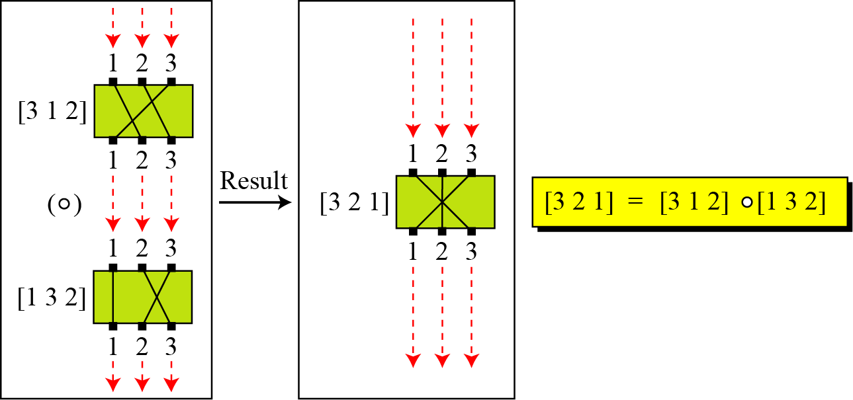
Permutation Group
A very interesting group is the permutation group. The set is the set of all permutations, and the operation is composition: applying one permutation after another.
Composition of permutation

Slide 41
Permutation Group…example
Table Operation table for permutation group
In the above example, we showed that a set of permutations with the composition operation is a group. This implies that using two permutations one after another cannot strengthen the security of a cipher, because we can always find a permutation that can do the same job because of the closure property.

Slide 42
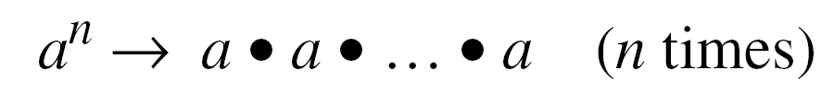
Cyclic Subgroups
If a subgroup of a group can be generated using the power of an element, the subgroup is called the cyclic subgroup.

Slide 43
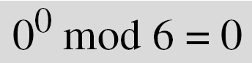
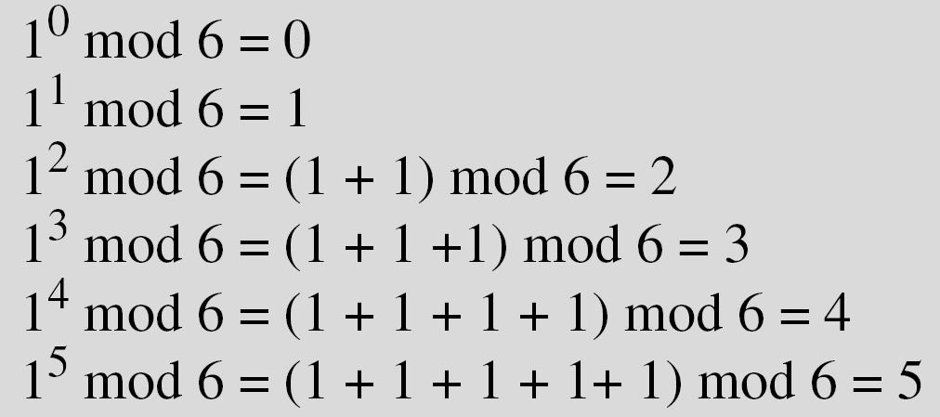
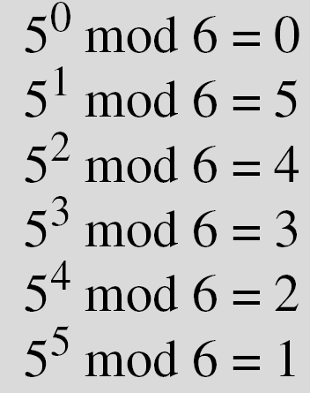
Cyclic Subgroups
Four cyclic subgroups can be made from the group G = <Z₆, +>. They are H1 = <{0}, +>, H2 = <{0, 2, 4}, +>, H₃ = <{0, 3}, +>, and H4 = G.

Slide 44
Sub-group: Example
Three cyclic subgroups can be made from the group G = <Z₁₀∗, ×>. G has only four elements: 1, 3, 7, and 9. The cyclic subgroups are H₁ = <{1}, ×>, H₂ = <{1, 9}, ×>, and H₃ = G.

Slide 45
Lagrange’s Theorem
Assume that G is a group, and H is a subgroup of G. If the order of G and H are |G| and |H|, respectively, then, based on this theorem, |H| divides |G|.
Order of an Element
The order of an element is the order of the cyclic group it generates.

Slide 46
Order of an Element
In the group G = <Z₆, +>, the orders of the elements are:
ord(0) = 1, ord(1) = 6, ord(2) = 3, ord(3) = 2, ord(4) = 3, ord(5) = 6.
In the group G = <Z₁₀*, ×>, the orders of the elements are: ord(1) = 1, ord(3) = 4, ord(7) = 4, ord(9) = 2.

Slide 47
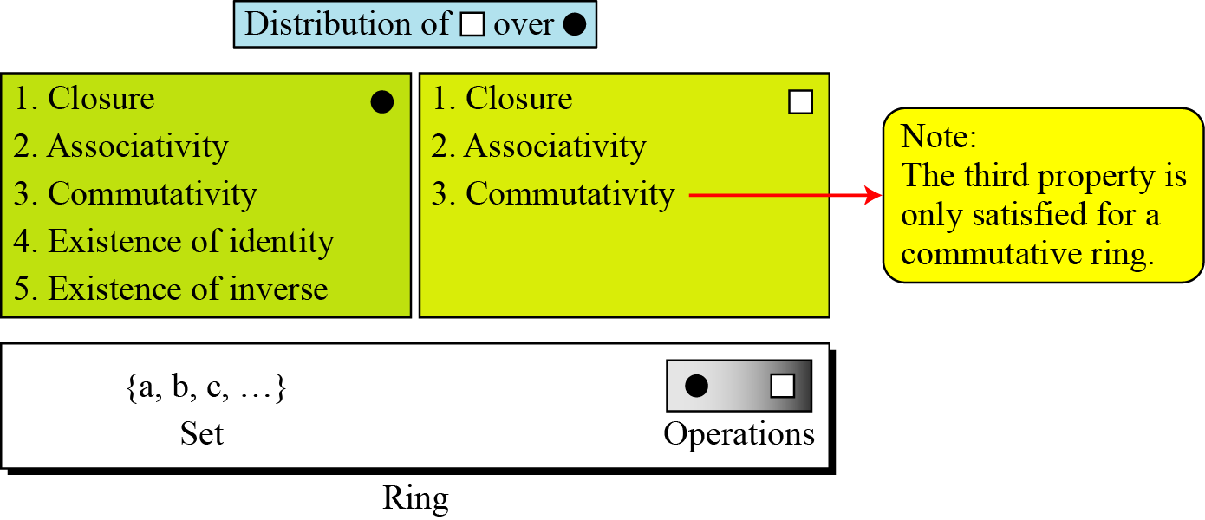
Ring
A ring, R = <{…}, •, >, is an algebraic structure with two operations.

Slide 48
The set Z with two operations, addition and multiplication, is a commutative ring. We show it by R = <Z, +, ×>. Addition satisfies all of the five properties; multiplication satisfies only three properties.

Slide 49
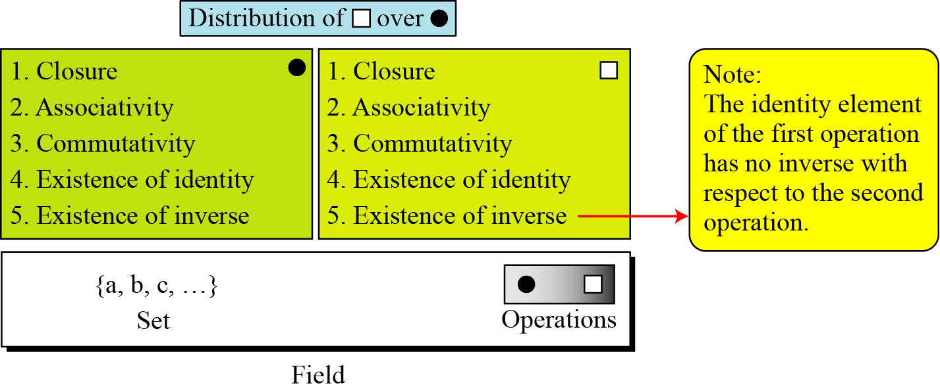
Field
A field, denoted by F = <{…}, •, > is a commutative ring in which the second operation satisfies all five properties defined for the first operation except that the identity of the first operation has no inverse.

Slide 50
Galois Field
Finite Fields
Galois showed that for a field to be finite, the number of elements should be p^{n}, where p is a prime and n is a positive integer.
A Galois field, GF(p^{n}), is a finite field with p^{n} elements.

Slide 51
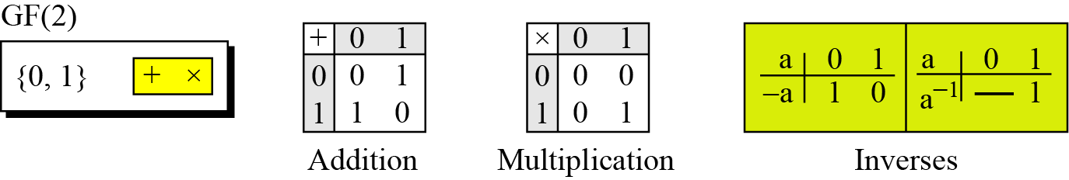
GF(2): An Example
A very common field in this category is GF(2) with the set {0, 1} and two operations, addition and multiplication.

Slide 53
4-2 GF(2^{n}) FIELDS
In cryptography, we often need to use four operations (addition, subtraction, multiplication, and division). In other words, we need to use fields. We can work in GF(2^{n}) and uses a set of 2^{n} elements. The elements in this set are n-bit words.
We can use GF(P), where p is the largest prime number less than 2^{n} . It is inefficient as we can not use the integers between p to 2^{n-1} . E.g. if n=4; the largest prime will be 13 i.e. we can not use integers 13,14,15.

Slide 54
Polynomials
A polynomial of degree n − 1 is an expression
of the form
where x^{i} is called the ith term and a_{i} is called coefficient of the ith term.

Slide 55
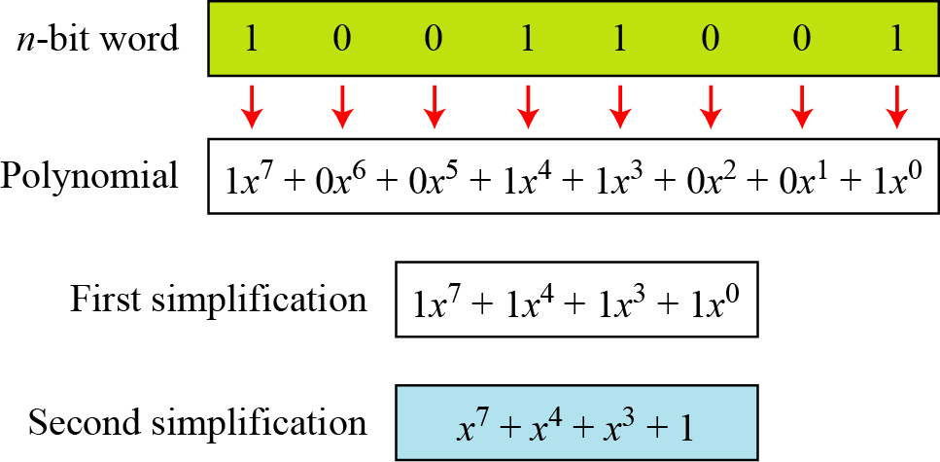
Representation of an 8-bit word by a polynomial

Slide 56
Irreducible Polynomials
For the sets of polynomials in GF(2^{n}), a group of polynomials of degree n is defined as the modulus. No polynomials in this set can divide this polynomial (prime). Such polynomials are referred to as irreducible polynomials.
List of irreducible polynomials

Slide 57
Example: Addition of Polynomials
Let us do (x⁵ + x² + x) ⊕ (x³ + x² + 1) in GF(2⁸). We use the symbol ⊕ to show that we mean polynomial addition. The following shows the procedure:
Add the coefficient s of the corresponding terms in GF(2). Use of modulus in not needed as the result always create a polynomial of degree (n-1).

Slide 58
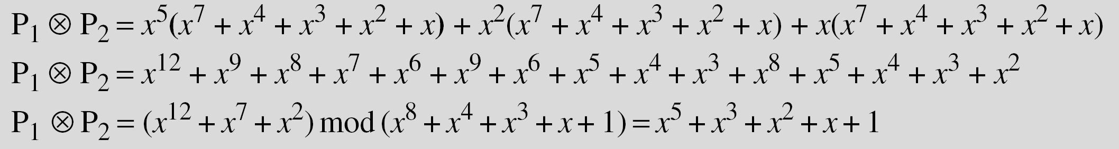
Example: Polynomial Multiplication
Find the result of (x⁵ + x² + x) ⊗ (x⁷ + x⁴ + x³ + x² + x) in GF(2⁸) with irreducible polynomial (x⁸ + x⁴ + x³ + x + 1). Note that we use the symbol ⊗ to show the multiplication of two polynomials.
Solution
To find the final result, divide the polynomial of degree 12 by the polynomial of degree 8 (the modulus) and keep only the remainder.

Slide 59
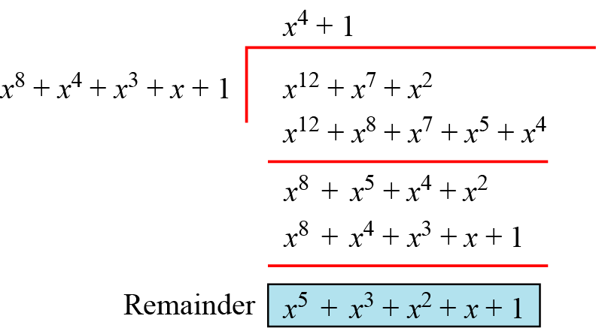
Polynomial division with coefficients in GF(2)

Slide 60
The Additive identity in a polynomial is zero polynomial.
The Additive inverse of a polynomial with coefficients in GF(2)
is the polynomial itself.
Multiplicative identity is always 1 i.e. in GF(2⁸) the multiplicative
inverse is 00000001.
Multiplicative inverse can be calculated using Extended Euclidean
algorithm.
.

Slide 61
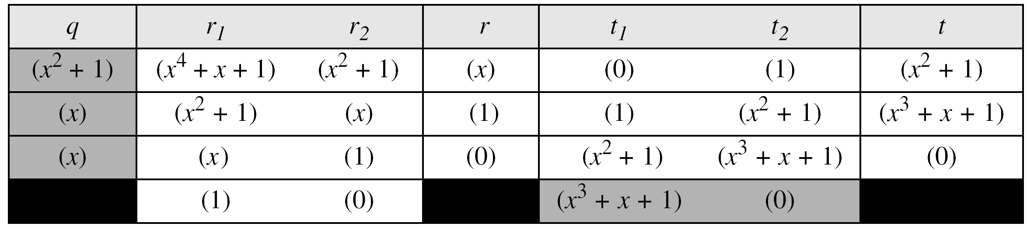
Multiplicative Inverse
In GF (2⁴), find the inverse of (x² + 1) modulo (x⁴ + x + 1).
Solution
The answer is (x³ + x + 1) as shown below.

Slide 62
Example
In GF(2⁸), find the inverse of (x⁵) modulo (x⁸ + x⁴ + x³ + x + 1).
Solution
The answer is (x⁵ + x⁴ + x³ + x) as shown below.

Slide 63
Example
Find the result of multiplying P₁ = (x⁵ + x² + x) by P₂ = (x⁷ + x⁴ + x³ + x² + x) in GF(2⁸) with irreducible polynomial (x⁸ + x⁴ + x³ + x + 1).
Solution
We first find the partial result of multiplying x⁰, x¹, x², x³, x⁴, and x⁵ by P₂. Note that although only three terms are needed, the product of x^{m} ⊗ P₂ for m from 0 to 5 because each calculation depends on the previous result.

Slide 64
An efficient algorithm

Slide 65
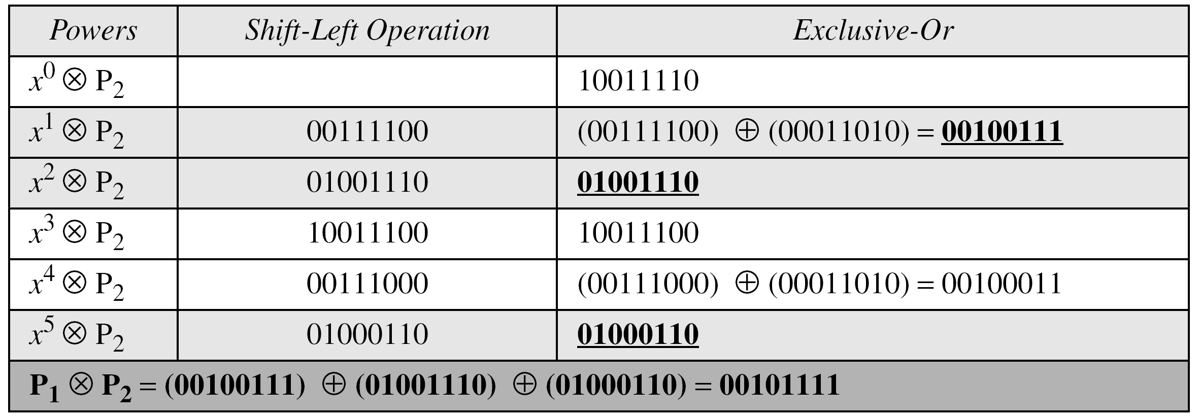
We have P1 = 000100110, P2 = 10011110, modulus = 100011010 (nine bits). We show the exclusive or operation by ⊕.
An efficient algorithm for multiplication using n-bit words

Slide 66
The GF(2³) field has 8 elements. We use the irreducible polynomial (x³ + x² + 1) and show the addition and multiplication tables for this field. We show both 3-bit words and the polynomials. Note that there are two irreducible polynomials for degree 3. The other one, (x³ + x + 1), yields a totally different table for multiplication.

Slide 67
Addition table for GF(2³)

Slide 68
Multiplication table for GF(2³)

Slide 69
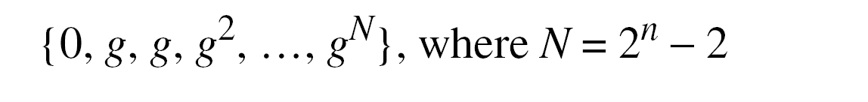
Using a Generator
Sometimes it is easier to define the elements of the GF(2^{n}) field using a generator. In this field with irreducible polynomial f(x); an element in the field a, must satisfy the relation f(a) = 0. If g is a generator, then f(g) = 0.

Slide 70
Generate the elements of the field GF(2⁴) using the irreducible polynomial ƒ(x) = x⁴ + x + 1.
The elements 0, g⁰, g¹, g2, and g³ can be easily generated, because they are the 4-bit representations of 0, 1, x², and x³. Elements g⁴ through g¹⁴, which represent x⁴ though x¹⁴ need to be divided by the irreducible polynomial. To avoid the polynomial division, the relation ƒ(g) = g⁴ + g + 1 = 0 can be used

Slide 72
The following show the results of addition and subtraction operations:
The finite field GF(2^{n}) can be used to define four operations of addition, subtraction, multiplication and division over n-bit words. The only restriction is that division by zero is not defined.

Slide 73
AES Origins
replacement for DES was needed
have theoretical attacks that can break it
have demonstrated exhaustive key search attacks
can use Triple-DES – but slow, has small blocks
US NIST issued call for ciphers in 1997
15 candidates accepted in Jun 98
5 were shortlisted in Aug-99
Rijndael was selected as the AES in Oct-2000
issued as FIPS PUB 197 standard in Nov-2001
Notes:
73
The Advanced Encryption Standard (AES) was published by NIST (National Institute of Standards and Technology) in 2001. AES is a symmetric block cipher that is intended to replace DES as the approved standard for a wide range of applications. The AES cipher (& other candidates) form the latest generation of block ciphers, and now we see a significant increase in the block size - from the old standard of 64-bits up to 128-bits; and keys from 128 to 256-bits. In part this has been driven by the public demonstrations of exhaustive key searches of DES. Whilst triple-DES is regarded as secure and well understood, it is slow, especially in s/w. In a first round of evaluation, 15 proposed algorithms were accepted. A second round narrowed the field to 5 algorithms. NIST completed its evaluation process and published a final standard (FIPS PUB 197) in November of 2001. NIST selected Rijndael as the proposed AES algorithm. The two researchers who developed and submitted Rijndael for the AES are both cryptographers from Belgium: Dr. Joan Daemen and Dr.Vincent Rijmen.

Slide 74
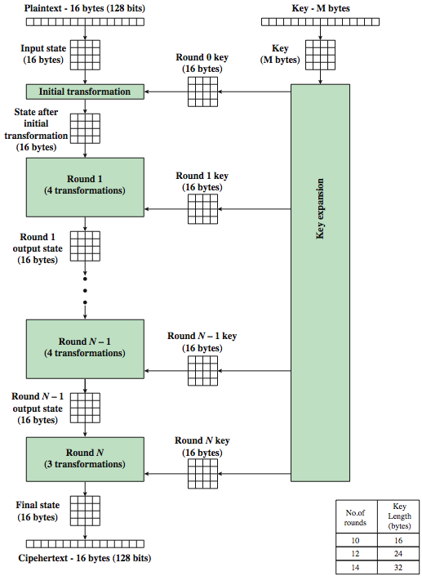
AES Encryption Process
Notes:
74
Stallings Figure 5.1 shows the overall encryption process in AES.

Slide 75
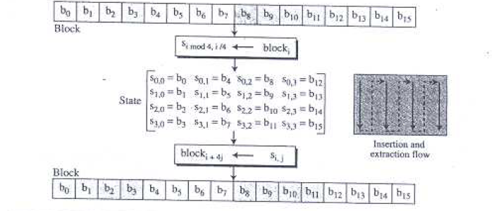

Slide 76
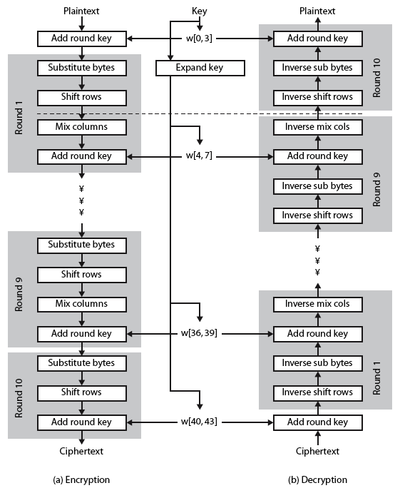
AES Structure
Notes:
76
Stallings Figure 5.3 shows the structure of AES in more detail. The cipher consists of N rounds, where the number of rounds depends on the key length: 10 rounds for a 16-byte key; 12 rounds for a 24-byte key; and 14 rounds for a 32-byte key. The first N – 1 rounds consist of four distinct transformation functions: SubBytes, ShiftRows, MixColumns, and AddRoundKey, which are described subsequently. The final round contains only 3 transformation, and there is a initial single transformation (AddRoundKey) before the first round, which can be considered Round 0. Each transformation takes one or more 4 x 4 matrices as input and produces a 4 x 4 matrix as output. Figure 5.1 shows that the output of each round is a 4 x 4 matrix, with the output of the final round being the ciphertext. Also, the key expansion function generates N + 1 round keys, each of which is a distinct 4 x 4 matrix. Each round key serve as one of the inputs to the AddRoundKey transformation in each round.

Slide 77
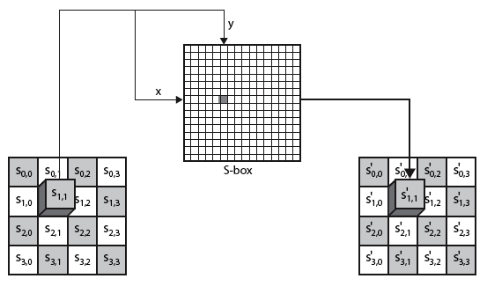
Substitute Bytes
Interpret the byte as two HEX digit; the left digit defines row (x) & the right digit defines
the column of S-box (y); the two hex digits at the junction of the row & col are the new
Byte .
Each byte is changed independently but the arrangement of the bytes in the matrix remains same.
Notes:
77
As this diagram from Stallings Fig 5.5a shows, the Byte Substitution operates on each byte of state independently, with the input byte used to index a row/col in the table to retrieve the substituted value.

Slide 78
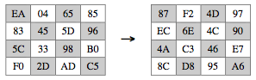
Substitute Bytes Example
The contents of each byte is changed, but the bytes are changed independently
Notes:
Show an example of the SubBytes transformation from the text.
78

Slide 79
Shift Rows
Byte level permutation (In DES permutation was at bit level)
A circular byte shift in rows
1st row is unchanged
2nd row does 1 byte circular shift to left
3rd row does 2 byte circular shift to left
4th row does 3 byte circular shift to left
Decrypt inverts using shifts to right
The order of the bits in the byte is not changed
Notes:
79
The ShiftRows stage provides a simple “permutation” of the data, whereas the other steps involve substitutions. Further, since the state is treated as a block of columns, it is this step which provides for diffusion of values between columns. It performs a circular rotate on each row of 0, 1, 2 & 3 places for respective rows. When decrypting it performs the circular shifts in the opposite direction for each row. This row shift moves an individual byte from one column to another, which is a linear distance of a multiple of 4 bytes, and ensures that the 4 bytes of one column are spread out to four different columns.

Slide 80
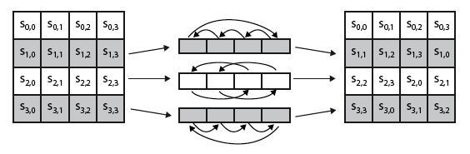
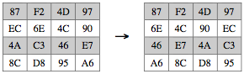
Shift Rows
Notes:
80
Stalling Figure 5.7a illustrates the Shift Rows permutation. Then show an example of ShiftRows from the text.

Slide 81
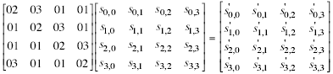
Mix Columns
Subbytes is an intra-byte transformation; Shiftrow is an byte exchange transformation
Interbyte transformation is needed each column is processed separately
each byte is replaced by a value dependent on all 4 bytes in the column
effectively a matrix multiplication in GF(2⁸) using prime poly m(x) =x⁸+x⁴+x³+x+1
Notes:
81
The forward mix column transformation, called MixColumns, operates on each column individually. Each byte of a column is mapped into a new value that is a function of all four bytes in that column. It is a substitution that makes use of arithmetic over GF(2^8). Each byte of a column is mapped into a new value that is a function of all four bytes in that column. It is designed as a matrix multiplication where each byte is treated as a polynomial in GF(2⁸). The inverse used for decryption involves a different set of constants.
The constants used are based on a linear code with maximal distance between code words – this gives good mixing of the bytes within each column. Combined with the “shift rows” step provides good avalanche, so that within a few rounds, all output bits depend on all input bits.

Slide 82

Mix Columns
Notes:
82
Stalling Figure 5.5b illustrates the Mix Columns transformation.

Slide 83


Mix Columns Example
Notes:
Show an example of the MixColumns transformation from the text, along with verification of the first column of this example.
83

Slide 84
AES Arithmetic
uses arithmetic in the finite field GF(2⁸) with irreducible polynomial m(x) = x⁸ + x⁴ + x³ + x + 1 which is (100011011) or {11b} e.g.
{02} • {87} mod {11b} = (1 0000 1110) mod {11b}
= (1 0000 1110) xor (1 0001 1011) = (0001 0101)
Notes:
AES uses arithmetic in the finite field GF(2⁸), with the irreducible polynomial m(x) = x⁸ + x⁴ + x³ + x + 1. AES operates on 8-bit bytes. Addition of two bytes is defined as the bitwise XOR operation. Multiplication of two bytes is defined as multiplication in the finite field GF(2⁸). In particular, multiplication of a value by x (i.e., by {02}) can be implemented as a 1-bit left shift followed by a conditional bitwise XOR with (0001 1011) if the leftmost bit of the original value (prior to the shift) is 1.
84

Slide 85
Mix Columns
can express each column as 4 equations
to derive each new byte in col
decryption requires use of inverse matrix
with larger coefficients, hence a little harder
have an alternate characterisation
each column a 4-term polynomial
with coefficients in GF(2⁸)
and polynomials multiplied modulo (x⁴+1)
Notes:
85
In practise, you implement Mix Columns by expressing the transformation on each column as 4 equations (Stallings equation 5.4) to compute the new bytes for that column. This computation only involves shifts, XORs & conditional XORs (for the modulo reduction).
The decryption computation requires the use of the inverse of the matrix, which has larger coefficients, and is thus potentially a little harder & slower to implement.
The designers & the AES standard provide an alternate characterisation of Mix Columns, which treats each column of State to be a four-term polynomial with coefficients in GF(2⁸). Each column is multiplied by a fixed polynomial a(x) given in Stallings eqn 5.7. Whilst this is useful for analysis of the stage, the matrix description is all that’s required for implementation.
The coefficients of the matrix are based on a linear code with maximal distance between code words, which ensures a good mixing among the bytes of each column. The mix column transformation combined with the shift row transformation ensures that after a few rounds, all output bits depend on all input bits. In addition, the choice of coefficients in MixColumns, which are all {01}, {02}, or {03}, was influenced by implementation considerations.

Slide 86

Add Round Key
It’s practically XOR ing of each column of the state with the
corresponding key word.
Notes:
86
Stallings Figure 5.5b illustrates the Add Round Key stage, which like Byte Substitution, operates on each byte of state independently.

Slide 87

AES Key Expansion
takes 128-bit (16-byte) key and expands into N 128 bit rounds key i.e. array of 44/52/60 32-bit words
Notes:
87
The AES key expansion algorithm takes as input a 4-word (16-byte) key and produces a linear array of words, providing a 4-word round key for the initial AddRoundKey stage and each of the 10/12/14 rounds of the cipher. It involves copying the key into the first group of 4 words, and then constructing subsequent groups of 4 based on the values of the previous & 4th back words. The first word in each group of 4 gets “special treatment” with rotate + S-box + XOR constant on the previous word before XOR’ing the one from 4 back. In the 256-bit key/14 round version, there’s also an extra step on the middle word. The text includes in section 5.4 pseudocode that describes the key expansion.

Slide 88

AES Example Key Expansion
Notes:
We now work through an example, and consider some of its implications. The plaintext, key, and resulting ciphertext are as follows:
Plaintext: 0123456789abcdeffedcba9876543210
Key: 0f1571c947d9e8590cb7add6af7f6798
Ciphertext: ff0b844a0853bf7c6934ab4364148fb9
Table 5.3 shows the expansion of the 16-byte key into 10 round keys. As previously explained, this process is performed word by word, with each four-byte word occupying one column of the word round key matrix. The left hand column shows the four round key words generated for each round. The right hand column shows the steps used to generate the auxiliary word used in key expansion. We begin, of course, with the key itself serving as the round key for round 0.
88

Slide 89

AES Example Encryption
Notes:
Next, Table 5.4 shows the progression of the state matrix through the AES encryption process. The first column shows the value of the state matrix at the start of a round. For the first row, the state matrix is just the matrix arrangement of the plaintext. The second, third, and fourth columns show the value of the state matrix for that round after the SubBytes, ShiftRows, and MixColumns transformations, respectively. The fifth column shows the round key. You can verify that these round keys equate with those shown in Table 5.3. The first column shows the value of the state matrix resulting from the bitwise XOR of the state after the preceding MixColumns with the round key for the preceding round.
89

